Slide 1
Python for Loop

Slide 2
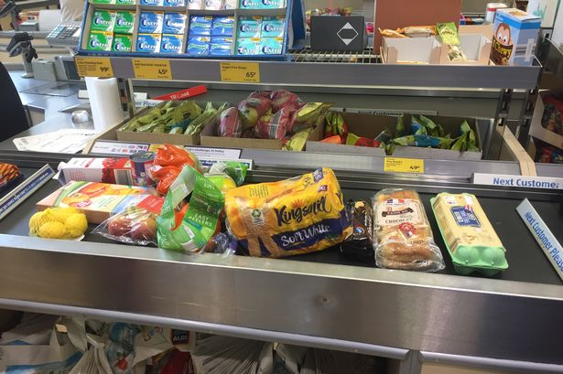
Iteration
Run shopping items through the till
for each item on the conveyor belt
scan the item
place it for bagging

Slide 3
Deterministic Loops
for each item on the conveyor belt
scan the item
4
7
1
8
place it for bagging
13
2
5
9
we could count the number of items
and then keep grabbing items until we reach the end of the count
14
3
6
11
10
12

Slide 4
Deterministic Loops
(the Python way)
for each item on the conveyor belt
scan the item
place it for bagging
or we could treat the items as a collection
and then go through them one at a time until we reach the end

Slide 5
Python for loop
for item in :
scan(item)
place_for_bagging(item)

Slide 6
Python for loop
basket = ['juice', 'cereal', 'lemons']
for item in basket:
scan(item)
place_for_bagging(item)

Slide 7
Python for loop
(loop in progress!)
basket = ['juice', 'cereal', 'lemons']
is there a first item? yes (True)
for item in basket:
scan(item)
place_for_bagging(item)
'juice'
'juice'
'juice'
grab the first item

Slide 8
Python for loop
(loop in progress!)
basket = ['juice', 'cereal', 'lemons']
is there another item? yes (True)
for item in basket:
scan(item)
place_for_bagging(item)
'cereal'
'cereal'
'cereal'
grab the next item

Slide 9
Python for loop
(loop in progress!)
basket = ['juice', 'cereal', 'lemons']
is there another item? yes (True)
for item in basket:
scan(item)
place_for_bagging(item)
'lemons'
'lemons'
'lemons'
grab the next item

Slide 10
Python for loop
(loop in progress!)
basket = ['juice', 'cereal', 'lemons']
is there another item? no (False)
for item in basket:
scan(item)
place_for_bagging(item)
'lemons'
'lemons'
'lemons'
no more items in the collection (exit)

Slide 11
Python for loop
The for loop iterates through a data collection
For example
[1, 3, 8, 2, 1, 9, 6]
["Phil", "Graham", "Jan", "Kelvin", "Chris", "Saeed"]
It can even iterate through a string (a collection of characters)
for <variable> in <collection>:
<statement>
<statement>
for letter in "word":
print(letter)

Slide 12
Python for loop
1 x 5 = 5
2 x 5 = 10
3 x 5 = 15
4 x 5 = 20
5 x 5 = 25
6 x 5 = 30
7 x 5 = 35
8 x 5 = 40
9 x 5 = 45
10 x 5 = 50
Reciting the five times table up to 10
where is the collection to iterate through?

Slide 13
Python for loop
1 x 5 = 5
2 x 5 = 10
3 x 5 = 15
4 x 5 = 20
5 x 5 = 25
6 x 5 = 30
7 x 5 = 35
8 x 5 = 40
9 x 5 = 45
10 x 5 = 50
Python lets you do this in a much better way
(but let's do it this way first)
multipliers = [1, 2, 3, 4, 5, 6, 7, 8, 9, 10]
This is called a list in Python (by the way) – more in week 6!

Slide 14
Python for loop
1 x 5 = 5
2 x 5 = 10
3 x 5 = 15
4 x 5 = 20
5 x 5 = 25
6 x 5 = 30
7 x 5 = 35
8 x 5 = 40
9 x 5 = 45
10 x 5 = 50
multipliers = [1, 2, 3, 4, 5, 6, 7, 8, 9, 10]
for num in multipliers:
print("{} x 5 = {}".format(num, num * 5))

Slide 15
range()
The range() function generates arithmetic progressions
Arguments must be integers
https://docs.python.org/3.3/tutorial/controlflow.html?highlight=range#the-range-function
pass a stopping point argument (non-inclusive) (progression will start at zero)
range(<stop>)
range(<start>, <stop>[, <step>])
range(5)
[0, 1, 2, 3, 4]

Slide 16
range()
The range() function generates arithmetic progressions
Arguments must be integers
https://docs.python.org/3.3/tutorial/controlflow.html?highlight=range#the-range-function
range(<stop>)
range(<start>, <stop>[, <step>])
pass a starting point argument (default zero)
and
a stopping point argument (non-inclusive)
optional step argument (size of progression step)
(default 1)
range(1, 6)
range(5, 51, 5)
[1, 2, 3, 4, 5]
[5, 10, 15, 20, 25, 30, 35, 40, 45, 50]

Slide 17
range()
The range() function generates arithmetic progressions
Arguments must be integers
https://docs.python.org/3.3/tutorial/controlflow.html?highlight=range#the-range-function
range(<stop>)
range(<start>, <stop>[, <step>])
range(5)
range(1, 6)
range(5, 51, 5)
[0, 1, 2, 3, 4]
useful when we start working with lists (collections)
[1, 2, 3, 4, 5]
useful for our 5 times table
[5, 10, 15, 20, 25, 30, 35, 40, 45, 50]

Slide 18
range()
The range() function generates arithmetic progressions
Arguments must be integers
You can also have a negative progression
https://docs.python.org/3.3/tutorial/controlflow.html?highlight=range#the-range-function
range(<stop>)
range(<start>, <stop>[, <step>])
passes a negative number as the step argument
range(10, 0, -1)
[10, 9, 8, 7, 6, 5, 4, 3, 2, 1]

Slide 19
Python for loop
1 x 5 = 5
2 x 5 = 10
3 x 5 = 15
4 x 5 = 20
5 x 5 = 25
6 x 5 = 30
7 x 5 = 35
8 x 5 = 40
9 x 5 = 45
10 x 5 = 50
multipliers = [1, 2, 3, 4, 5, 6, 7, 8, 9, 10]
for num in multipliers:
print("{} x 5 = {}".format(num, num * 5))
we need the first number to be 1, not the default of zero
don't forget, the stop argument is not inclusive – we want the final number to be 10
for num in range(1, 11):
print("{} x 5 = {}".format(num, num * 5))

Slide 20
Finally for…else
for also has an else clause that you can make use of
Needle in a haystack example
haystack = ["tree", "flower", "grass"]
needle = "something else"
for item in haystack:
if item == needle:
print("The item was found")
break
else:
print("The item wasn't found")
break exits the loop (no passing go! (or triggering else))
there is also continue which jumps immediately to the next iteration (if any are left)
problems can arise because we're setting more than one place where a test is made to end the loop

Slide 21
Common Errors
for i in range(10)
print("i is:", i)
where is the error and why?

Slide 22
Common Errors
for i in range(10);
print("i is:", i)
where is the error and why?

Slide 23
Common Errors
for i in range(10, 0):
print("i is:", i)
where is the error and why?

Slide 24
Any questions?

